Slide 1
Railway reservation system
Created by: Ekansh MISHRA
Ashish asthana
Arya tyagi
Ashish kumar sharma

Slide 2

Railway reservation system
This is a railway reservation system which books the train for the users, this system is made up with the integration of python as a scripting language and MySQL as a structured query language.
This portal is capable of planning the train journey , booking the train , modifying and cancelling the ticket as per users request.

Slide 3
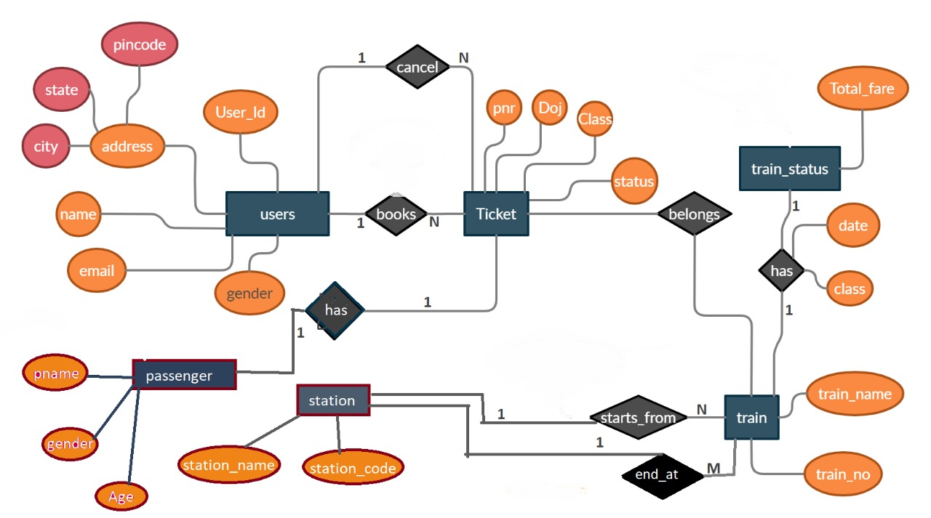
E.r diagram
This Entity Relationship diagram shows how tables are connected and relation between them.
Main Tables
Users – Contains all the user data.
Ticket – Consists of details of train ticket.
Station – have names and id of stations.
Passenger – details of passengers travelling.
Train – consists of train name and train number.
Train status – consists of fare , date and class of the train journey.

Slide 4
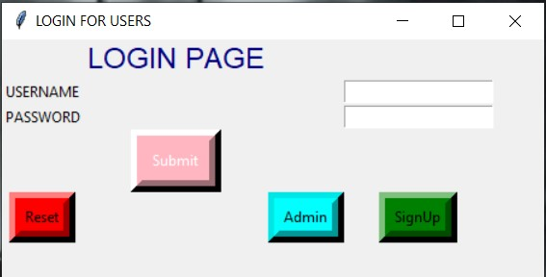
Log-in page
This is the log-in page
Consists of username and password field
It has submit button , admin button , signup button , reset button which are used for specified functions.
This login panel made with python and integrated with MYSQL for database support
Login page is used by user and administrator to sign-in and signup to the portal

Slide 5
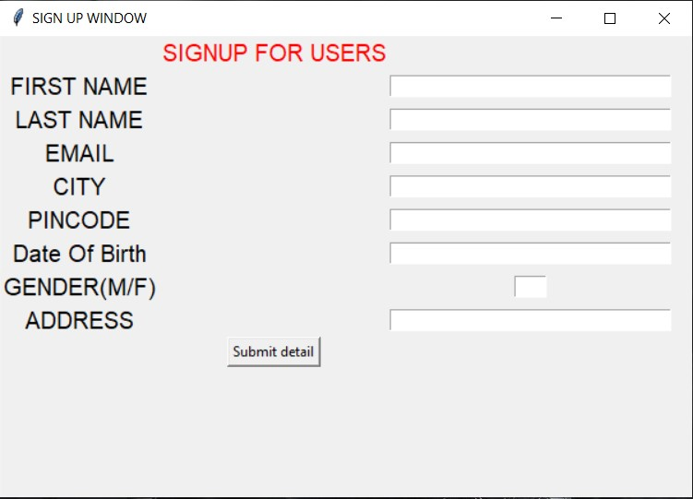
Sign up
-------------------Sign-Up------------------------
This portal is used by new user to register themselves to the railway reservation system.
This system takes all the basic details required by system to book the train ticket and securely provide ticket.
Users will fill all the fields because the given fields all mandatory.

Slide 6
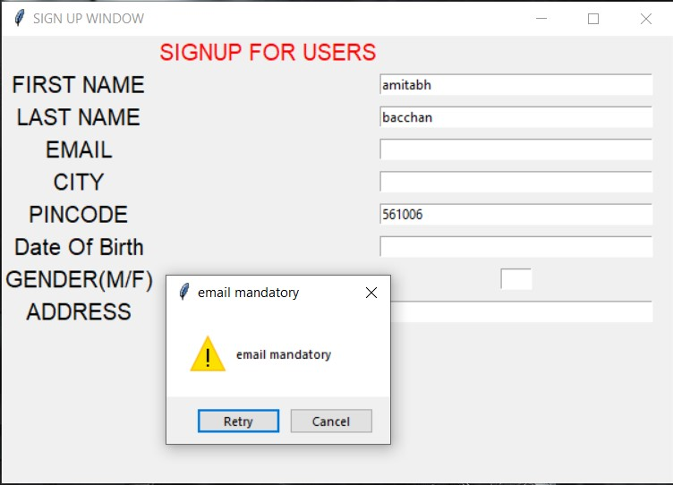
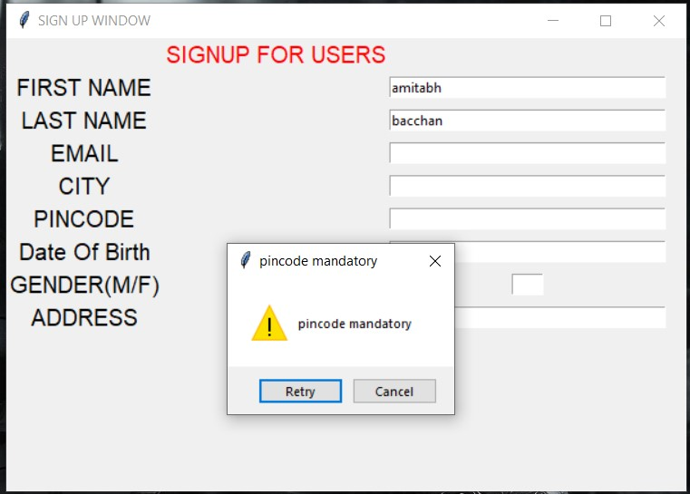
Sign up
Fields are mandatory.

Slide 7
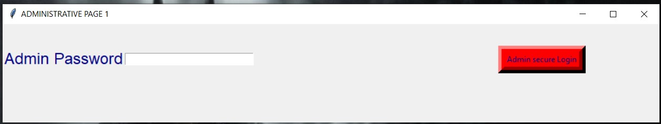
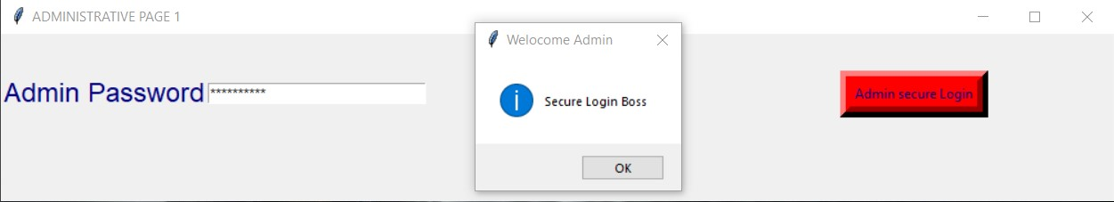
admin
-----------------Admin log in panel--------------
Admin panel is used by Administrator .
Admin portal only asks admin password as administrator has the master password so that he/she can manage the railway reservation system

Slide 8
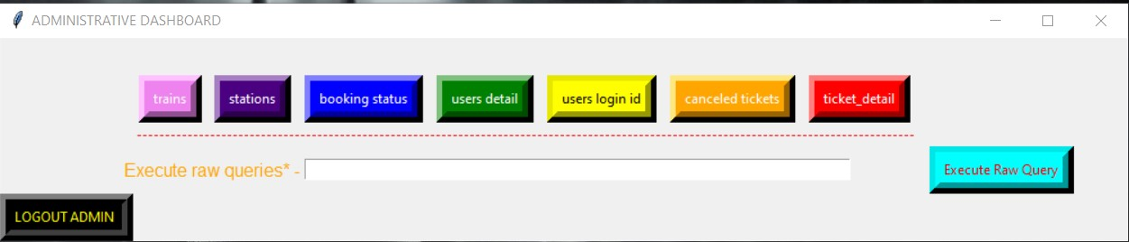
admin
--------------------Admin panel-----------------
Admin panel have control over all the tables in the database , it can select any table and execute a raw SQL command to have or give CRUD(Create Read Update Delete) details.

Slide 9
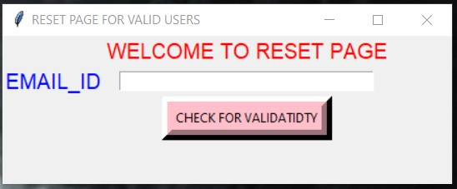
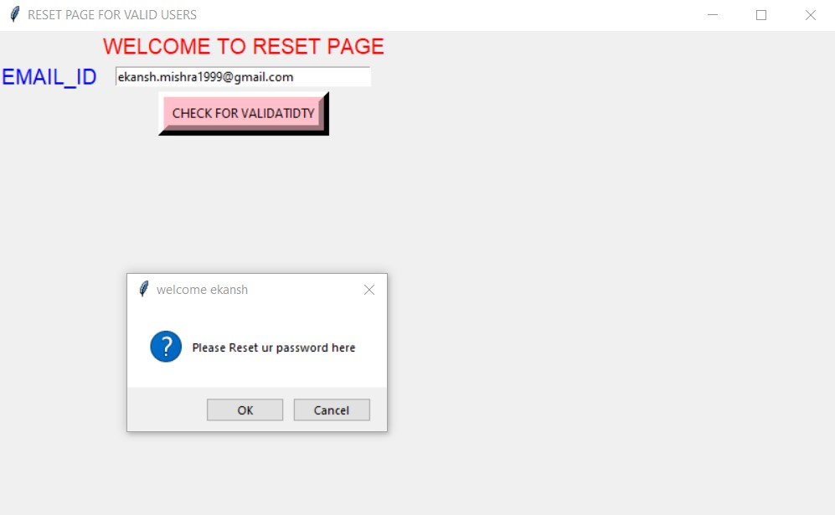
reset
--------------password reset page-------------
Reset portal is used by user when they forgot their password to the railway reservation system.
Firstly it will confirm that the email id is registered.
Then it asks for new password to enter.

Slide 10
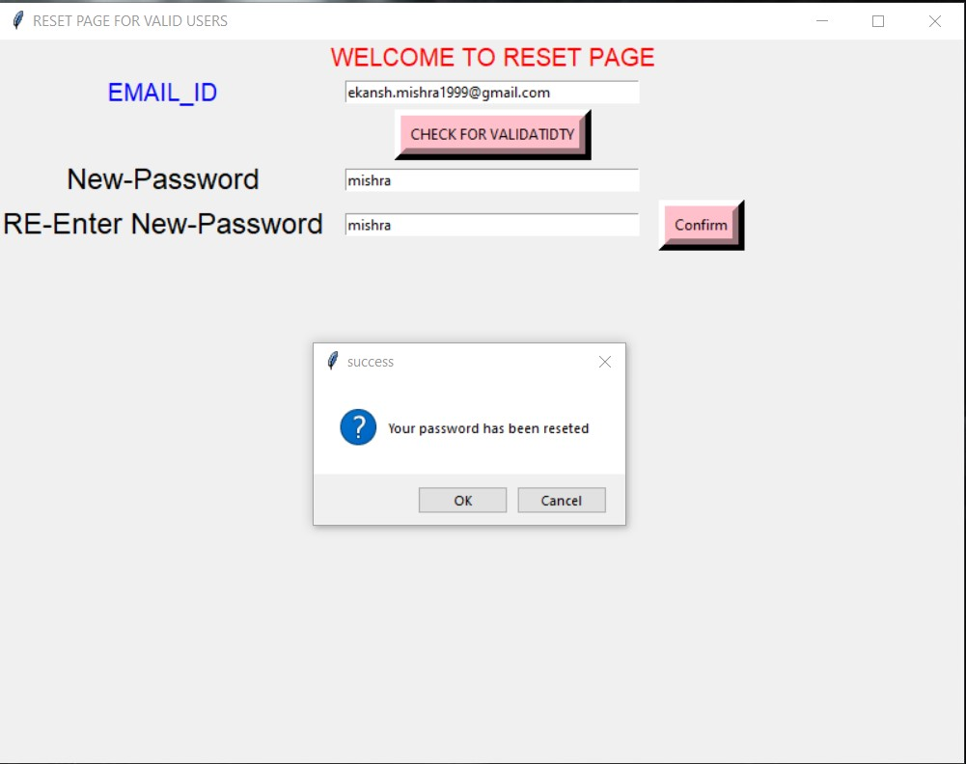
reset
----------------Password reset page-------------
It will asks the passwords two times and if they are correct , the portal will update the password for the following user.

Slide 11
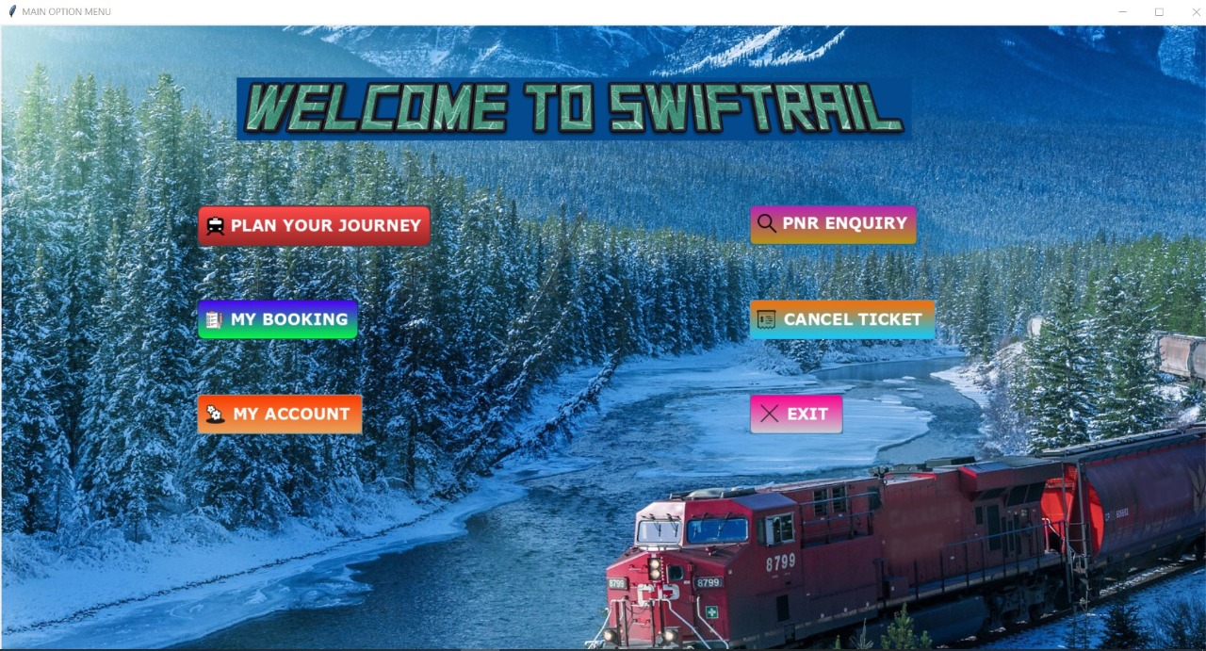
Main page
This is the main page consists of leading buttons whose focus is to help user to book ticket , cancel ticket , look for booked ticket query and details about the user stored in the portal.
Buttons shown :
Plan your journey
My booking
My account
PNR enquiry
Cancel Ticket

Slide 12
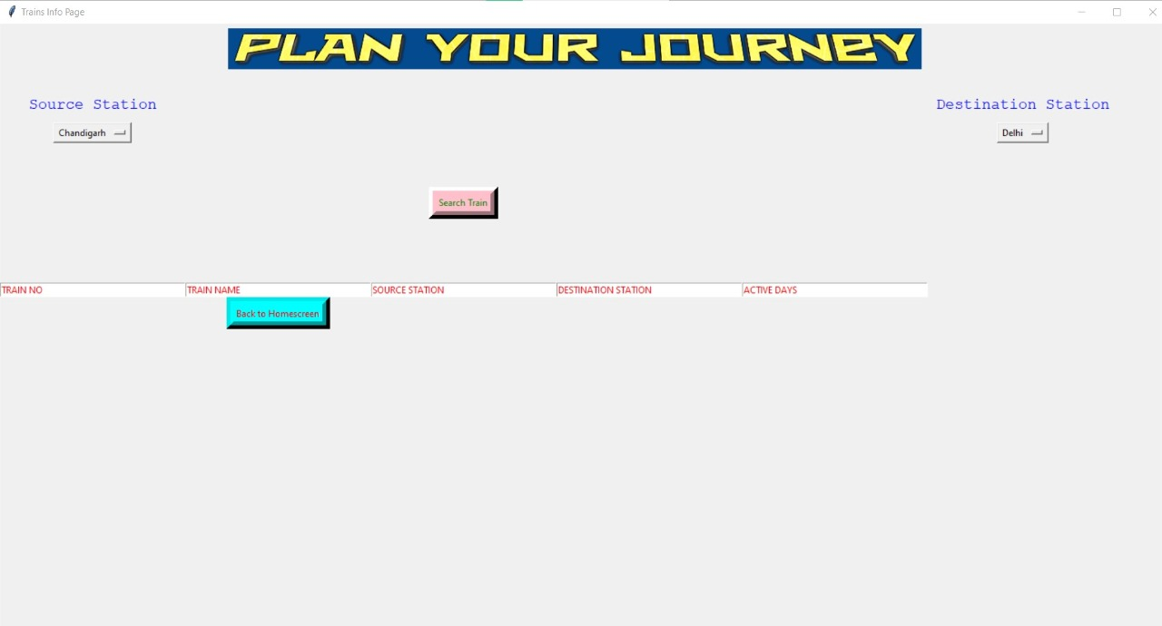
Plan your journey
-------------PLAN YOUR JOURNEY--------------
It is a page in portal where user selects the source station and destination station to get the information about transiting trains between stations.

Slide 13
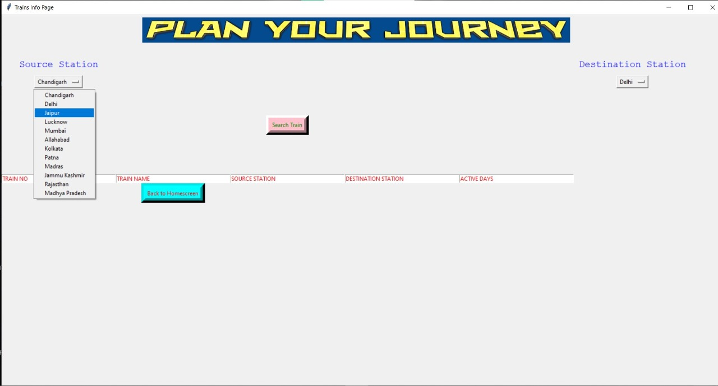
Plan your journey
User selects stations through source station and destination station by choosing from respective Items from comboxes provided.
User selects the station and press the search button then all the data about all the trains are fetched from database to the following table.

Slide 14
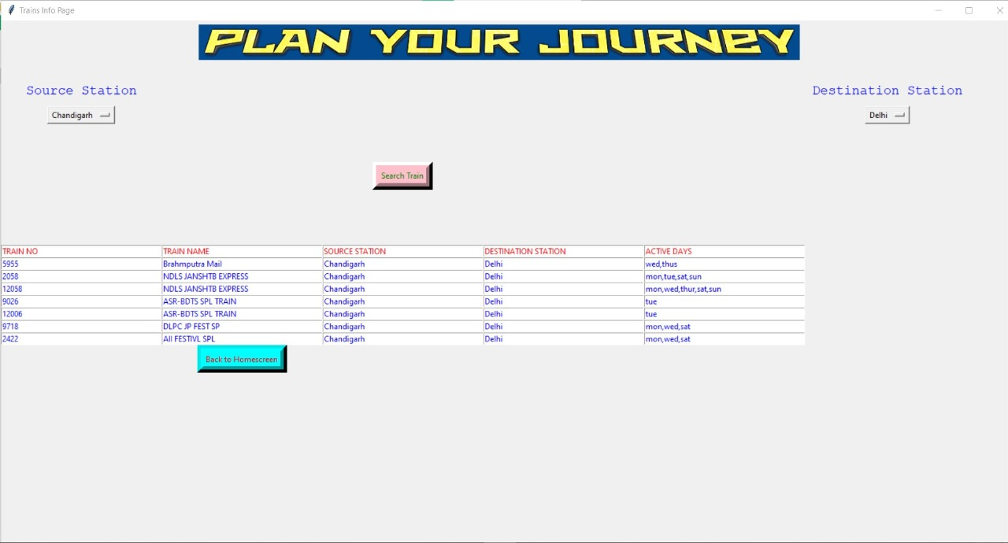
Plan your journey
It shows all the trains between following stations , asked by the user.

Slide 15
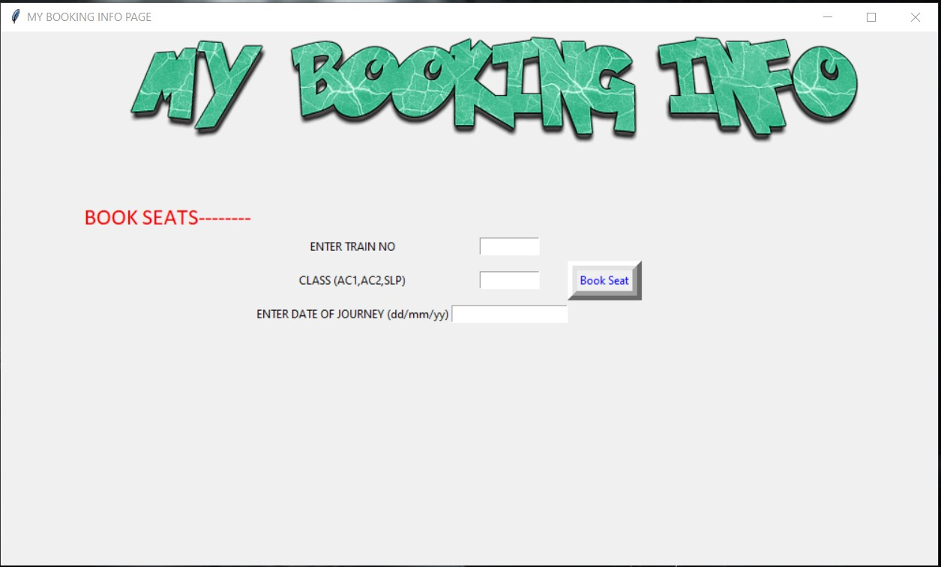
My bookings
------------------My Booking Info----------------
This portals books the ticket
When user sees all the trains from previous portal they will put the train number , class and date of journey to book the train.

Slide 16
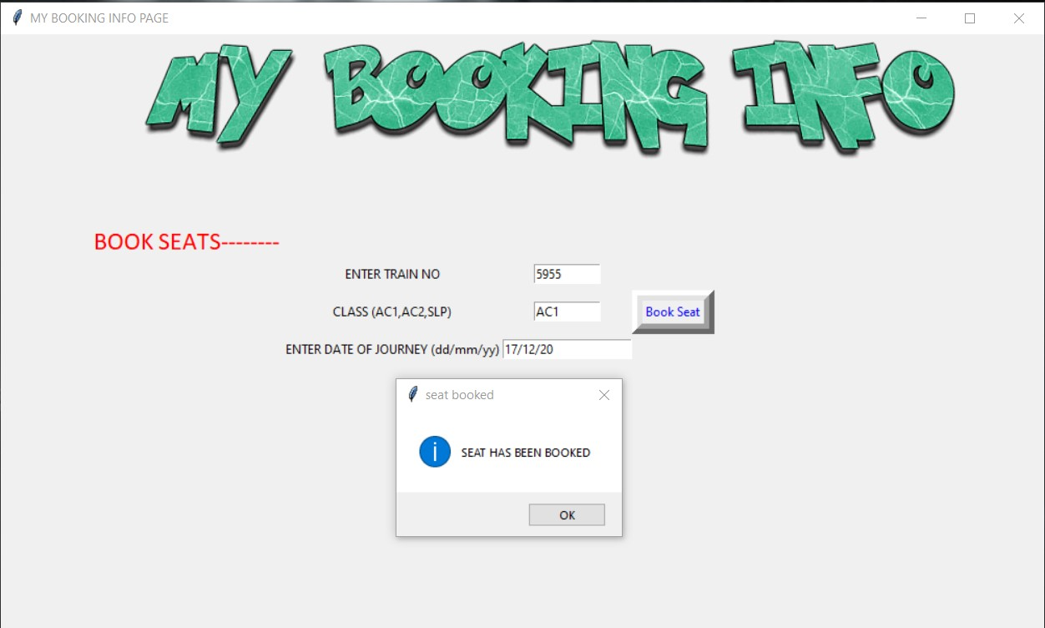
My bookings
When all the details are filled and user will enter Book Seat , then database gets updated and a dialog box appears which shows that seats are booked.

Slide 17
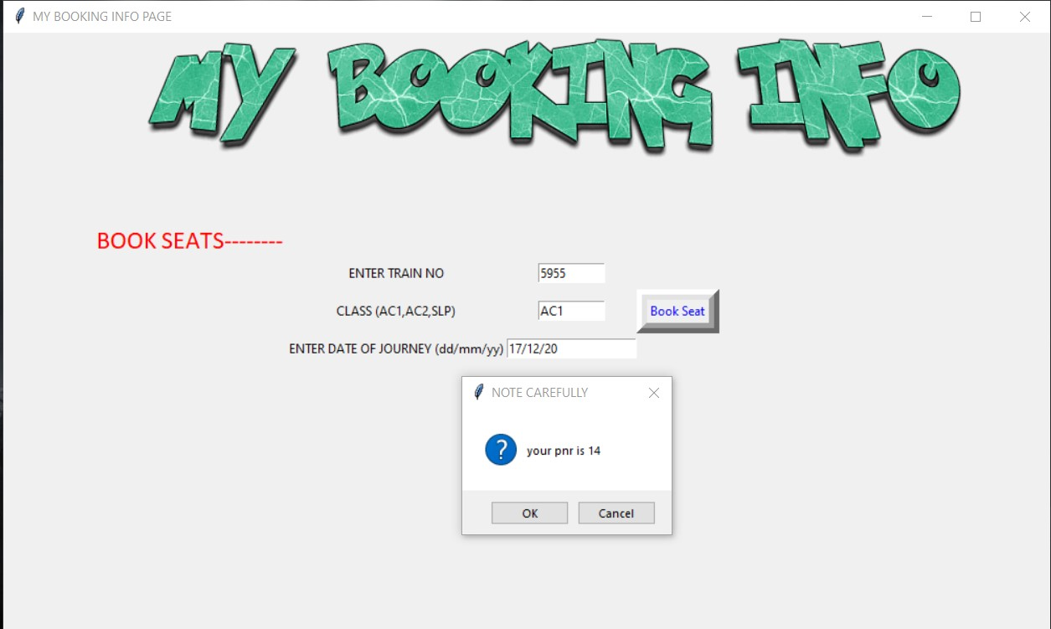
My bookings
It will also show your PNR NO. in the following dialog box.

Slide 18
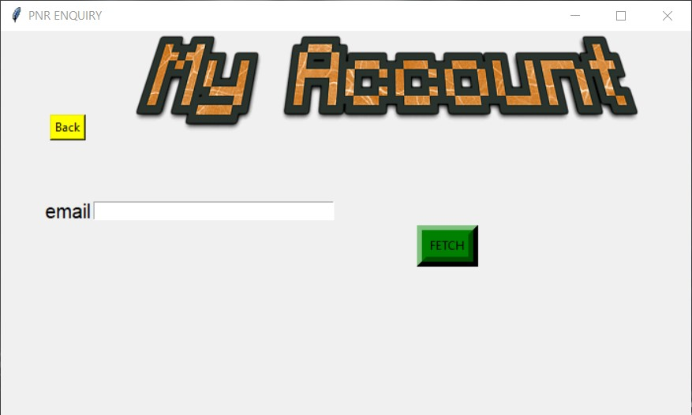
My account
---------------------My account-------------------
In my account portal we can fetch all the data about user which portal have.
User inputs the registered Email-Id and when user press the fetch button it searches the database and show all the user details are stores in the portal.

Slide 19
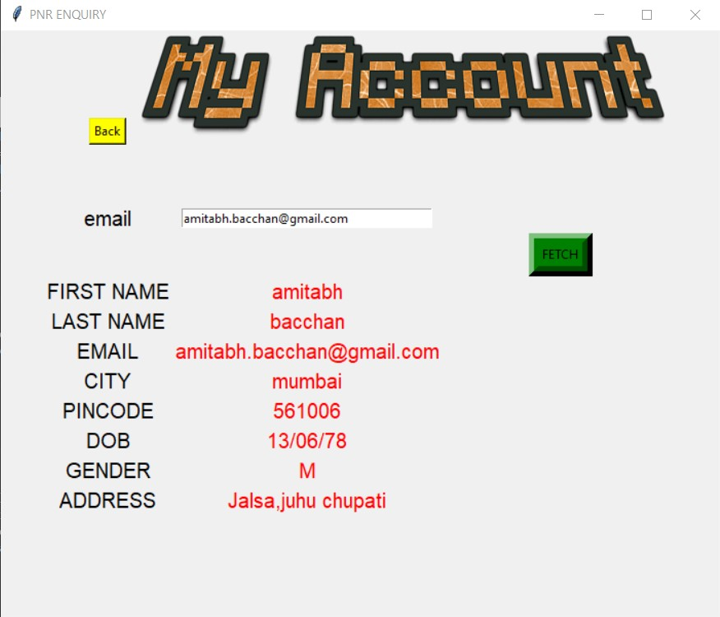
My account
It shows all the details about the user.

Slide 20
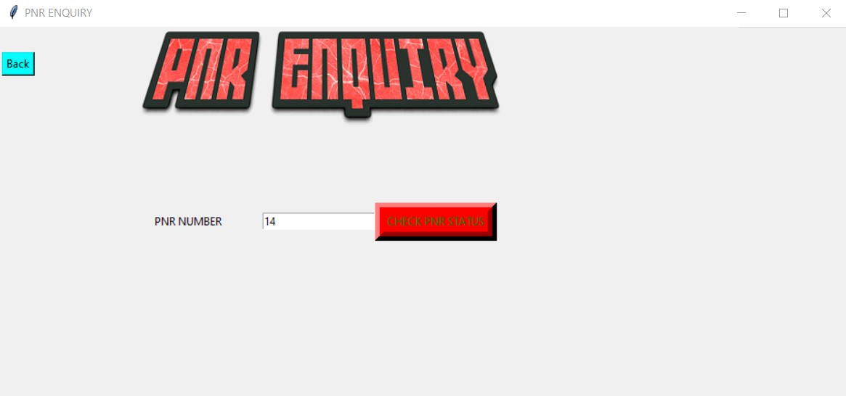
PNR ENQUIRY
In this portal user enter the given PNR number and press the button to get the running status of the booked train.

Slide 21
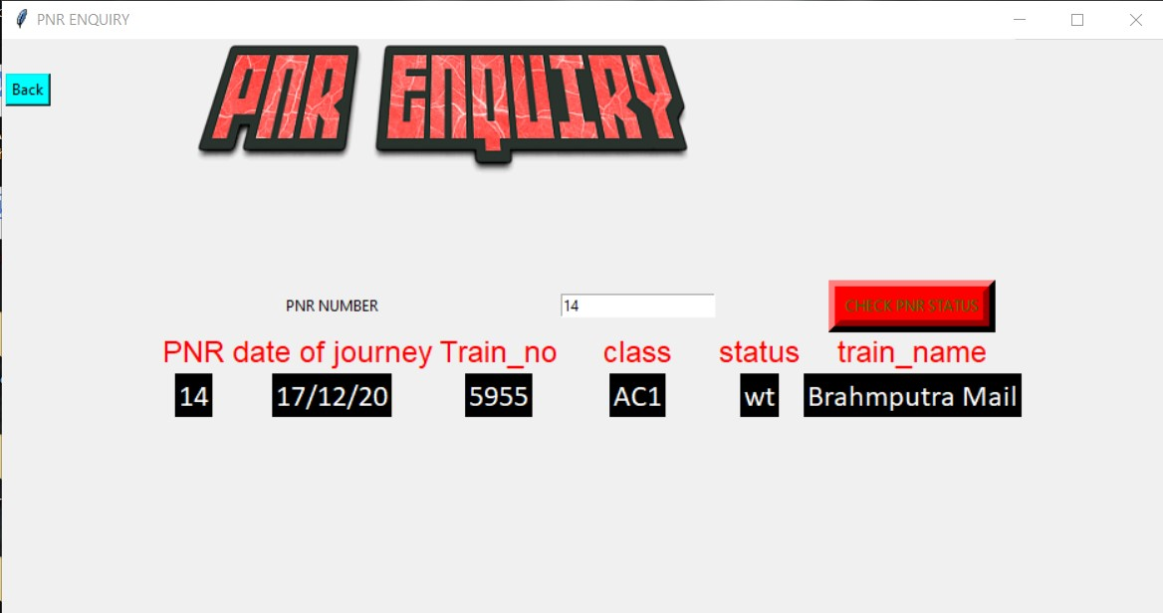
PNR ENQUIRY
It shows the user all the details about the train by using the given PNR number.

Slide 22
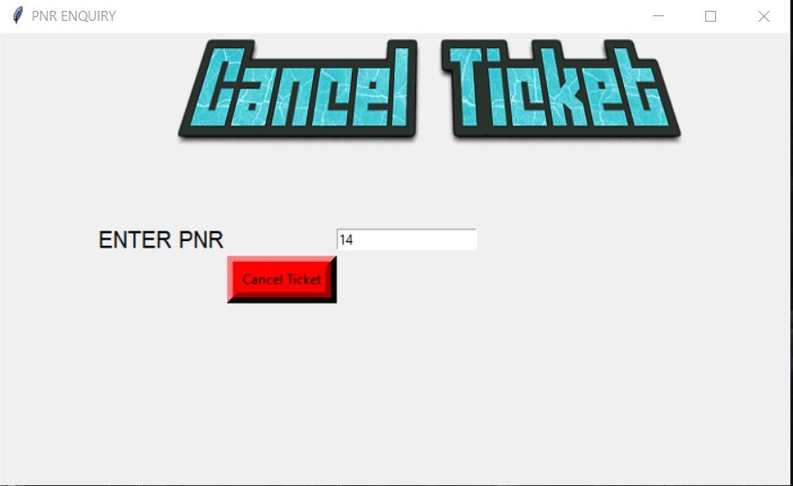
Cancel ticket
----------------- Cancel Ticket-------------------
This portal accepts the PNR number from the user and cancels the following ticket from booked ticket portal.

Slide 23
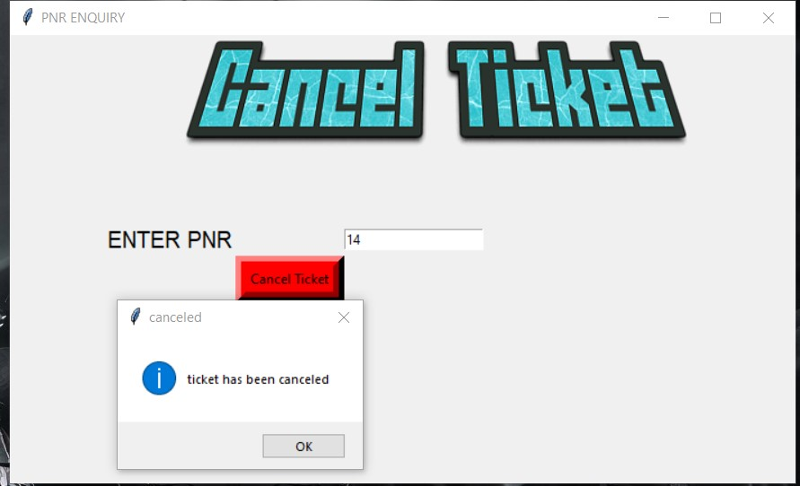
Cancel ticket
Cancelled the ticket using given PNR number.

Slide 24
Thanks.

